Slide 1
current capabilities and future possibilities
coherent optical transceivers
Dr. Gerhard Stein und Thomas Weible
Notes:
Welcome - these slides are made by Thomas our CTO and Gerhard our Head of Product Development at FLEXOPTIX
Coherent pluggable transceivers have been introduced with the speed of 400G. They will be a game changer in optical transmission and were coming to stay for a long time in networking. The Theory and practical usage / troubleshooting is addressed by this presentation.

Slide 2
100G ecosystem limits ...
2
ratio of power consumption to formfactor
focus on inner datacenter links
variation of diverse hardware
CFP​
QSFP28
^{divers}
CFP2​
CFP4
CPAK
1
Notes:
+ CFP provided a lot of power (> 20Watt) but size was huge; implementation was very complicated. Not many adopters of system manufacturers
+ CFP2 tried to catch up but never made it; CPAK was a Cisco proprietary solution
+ CFP4 never really launched
+ QSFP28 nice from factor, huge quantities but sadly only max. 5 Watt power consumption (incl. the switches and router did not provide enough power / cooling)

Slide 3
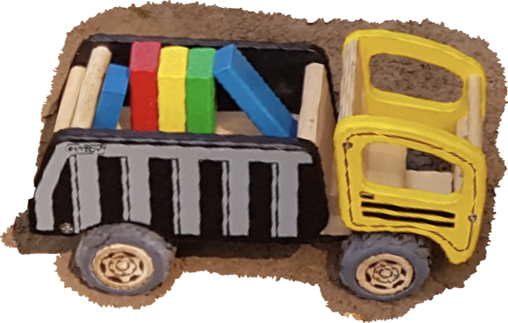
… sorted now with 400G
DWDM transponder card
DSP 28nm
pluggable QSFP-DD
DSP 7nm
TX
RX
TX
RX
2
Notes:
+ DSPs have been around for a while but latest chip manufacturing techniques and volume made small pluggables possible. + The DWDM transponder cards have been mainly used in metro and long haul transmission system and also for subsea links.
+ switching and routing hardware has sufficient power and cooling capabilities – see slide "analysis with the CLI" in the second part.
+ edge datacenters need high bandwidth interconnects between each other
+ only two formfactors – the widely used QSFP-DD and OSFP

Slide 4
source: [4]
Notes:
full
+ Taken from the 400G real world expample presentation from Arista. They have build two spans of several hundrets of kilometer each in Turkey.
+ OpenZR+ and OIF did define important coherent specs

Slide 5
Notes:
full fun fact: when Flexoptix was founded in 2008 the transceiver were unsupported. Now things have changed ;-)

Slide 6
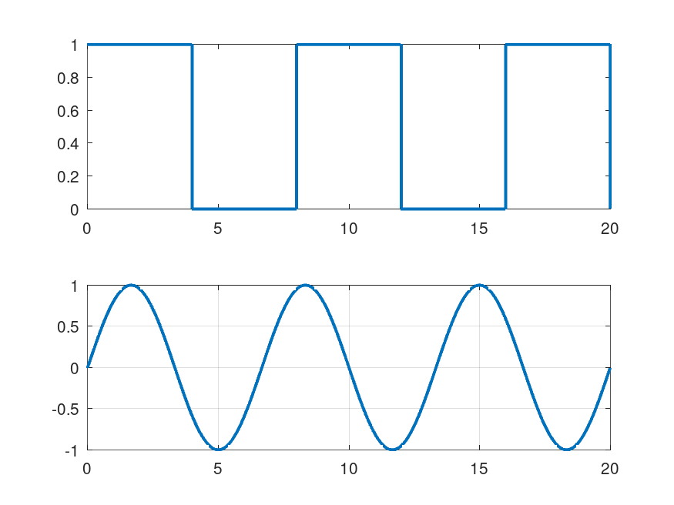
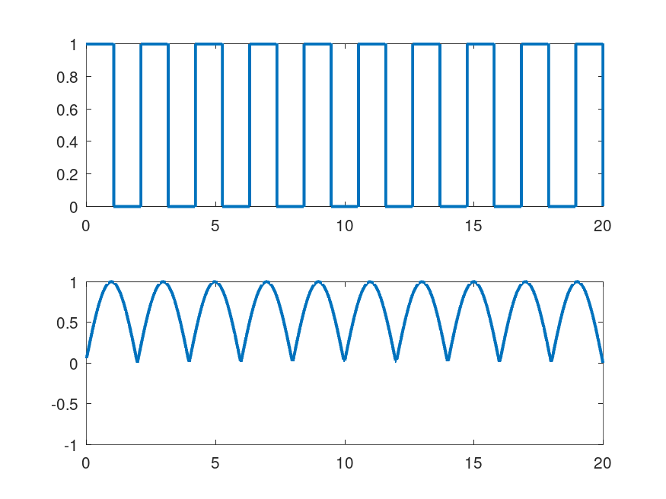
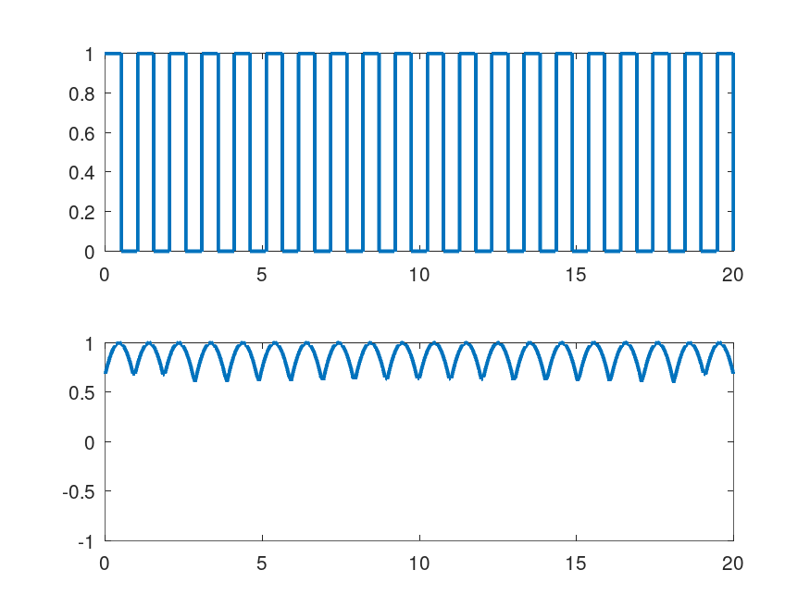
Direct Detection Transceiver limits
With higher frequencies -> harder for Photodiodes to detect signal
increase
Missed Opportunity: Light has more Properties
Notes:
+ let’s start with the challenges and problems with direct detection transceivers and higher frequencies.
+ these timing diagrams are the foundation for eye diagrams and were sufficient so far.

Slide 7
Direct Detection Transceiver limits
With higher frequencies -> harder for Photodiodes to detect signal
more
Missed Opportunity: Light has more Properties

Slide 8
Direct Detection Transceiver limits
With higher frequencies -> harder for Photodiodes to detect signal
Missed Opportunity: Light has more Properties
Notes:
+ only focusing on a frequency driven amplitude (only 1bit/symbol for OnOff Keying modulation) does miss further opportunities as photonic signal have more properties to observe; to do so a small system capable of doing more is needed to be build …

Slide 9
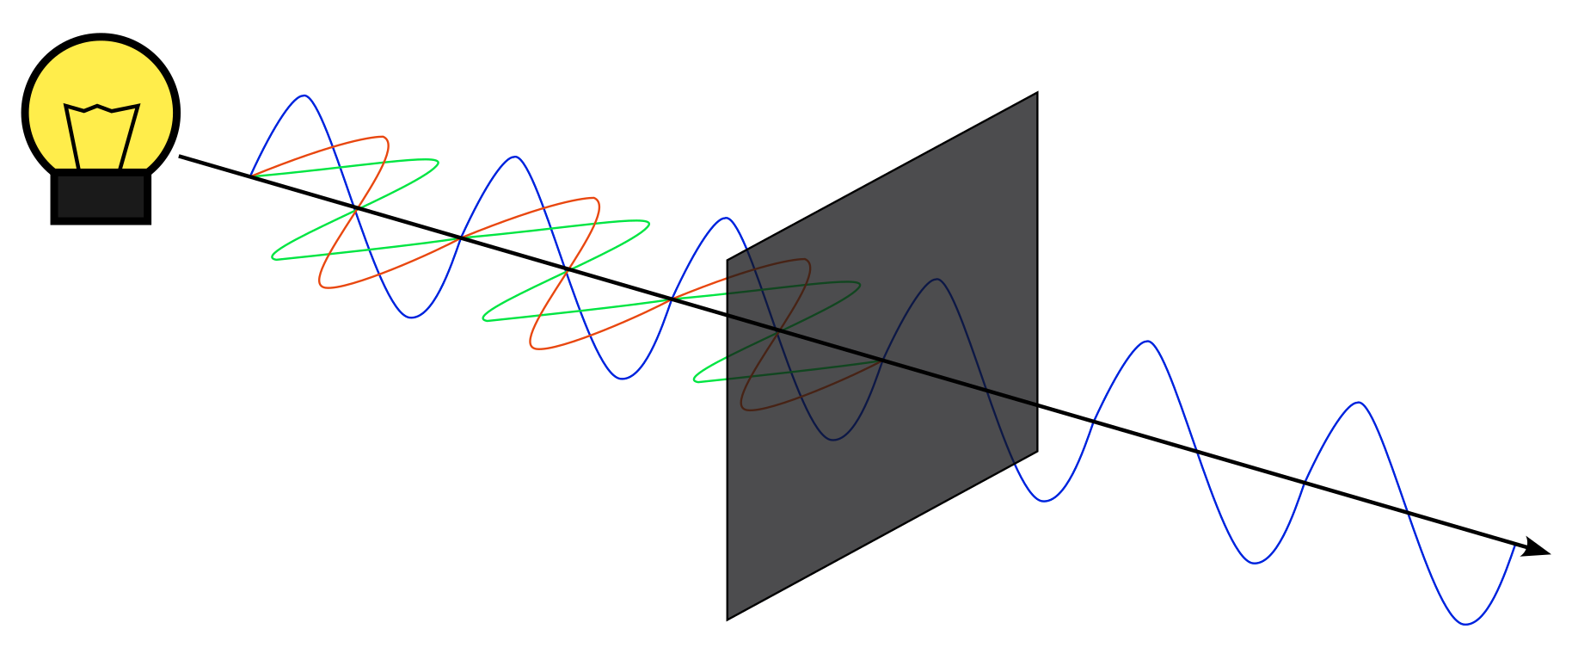
Main Properties of Photonic Waves
Besides Amplitude, also Phase and Polarisation
More properties per Carrier = Higher Bandwidth
Notes:
+ besides amplitude we can also send a phase shifted wave. But first let’s look at the polarisation.
+ with a polarisation filter only certain directions are allowed and taken in consideration. We can use this to add more bits (higher density) per symbol to the transmission data. This is a very important characteristic for modulation.
+ next we have a look at Dual Polarization (X and Y plane) of a 16-QAM modulated signal.

Slide 10
Polarisation Signal on X and Y Plane
Notes:
Talk about the tube that describes the Fiber.
at sec 5: only Y Plane is shown
Now it rotates to X Plane
at sec 10: only X Plane is shown (you see different curve)
rotates little back and then it becomes isometric with both Planes, the entire signal
You might have heard of eye diagramms. Imagine one applied to that 3D signal. Most likely it will be difficult to see the expected opened eye. Also it is hard to see how clean this signal is, and how the errors are. So let’s use a different way to describe these numbers. For that matter I will have to tortue you with math and complex numbers. No other way around. No worries, it ain’t that bad.

Slide 11
Polarisation Signal on X and Y Plane

Slide 12
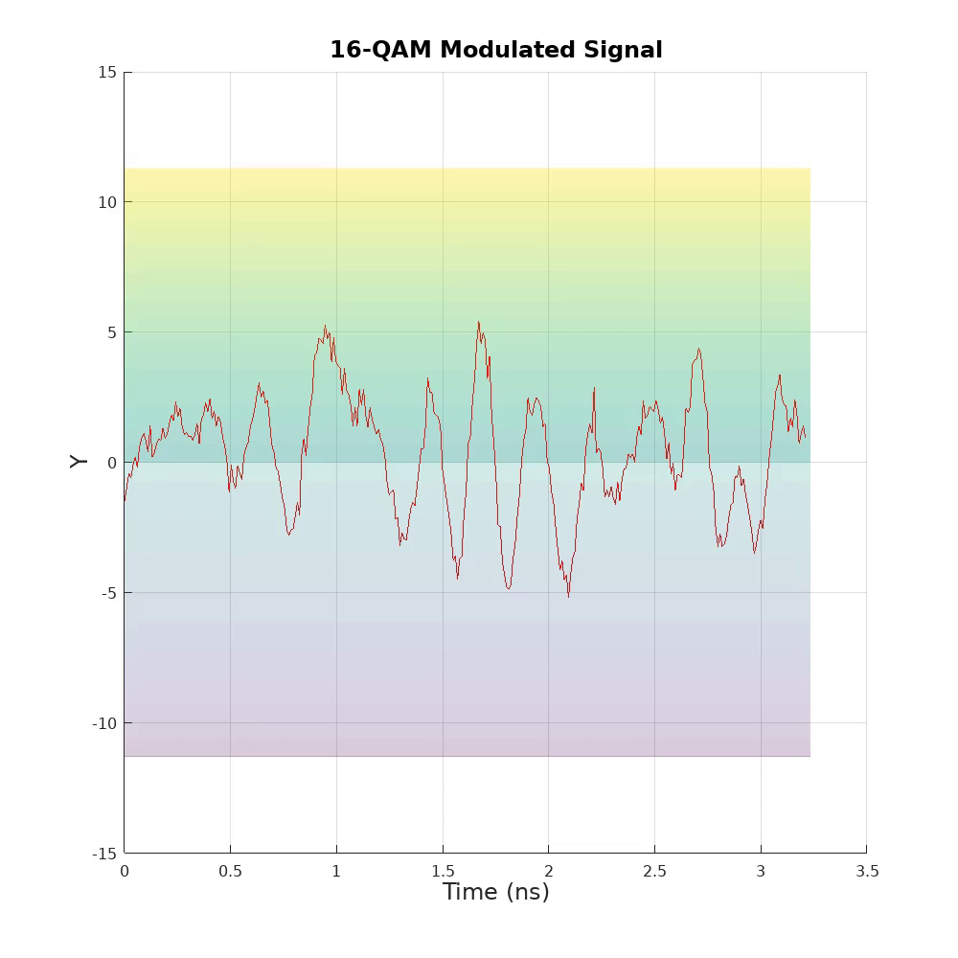
Polarisation Signal on X and Y Plane
Notes:
Slide only for presenter computer if no PowerPoint is available.

Slide 13
Polarisation Signal on X and Y Plane

Slide 14
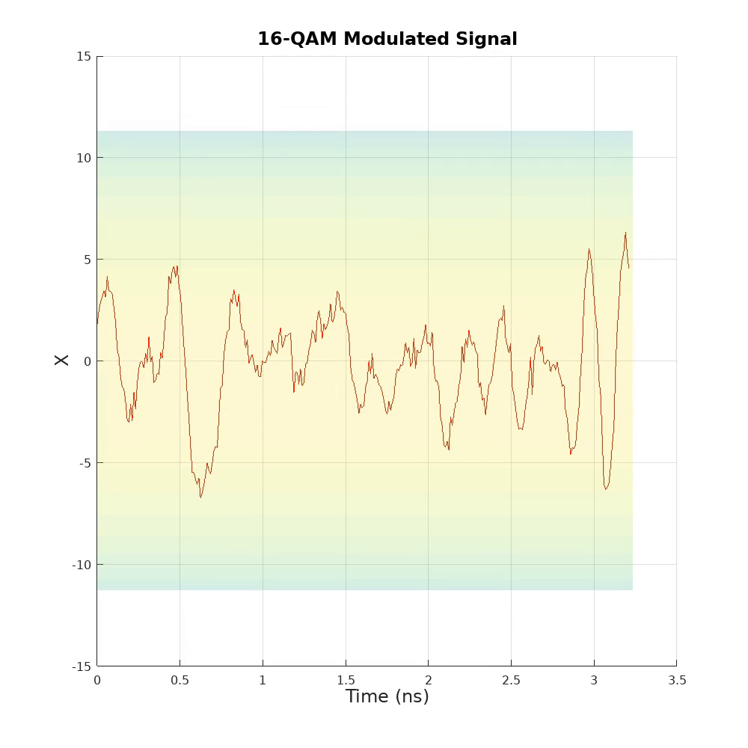
Polarisation Signal on X and Y Plane
Notes:
Slide only for presenter computer if no PowerPoint is available.

Slide 15
Polarisation Signal on X and Y Plane

Slide 16
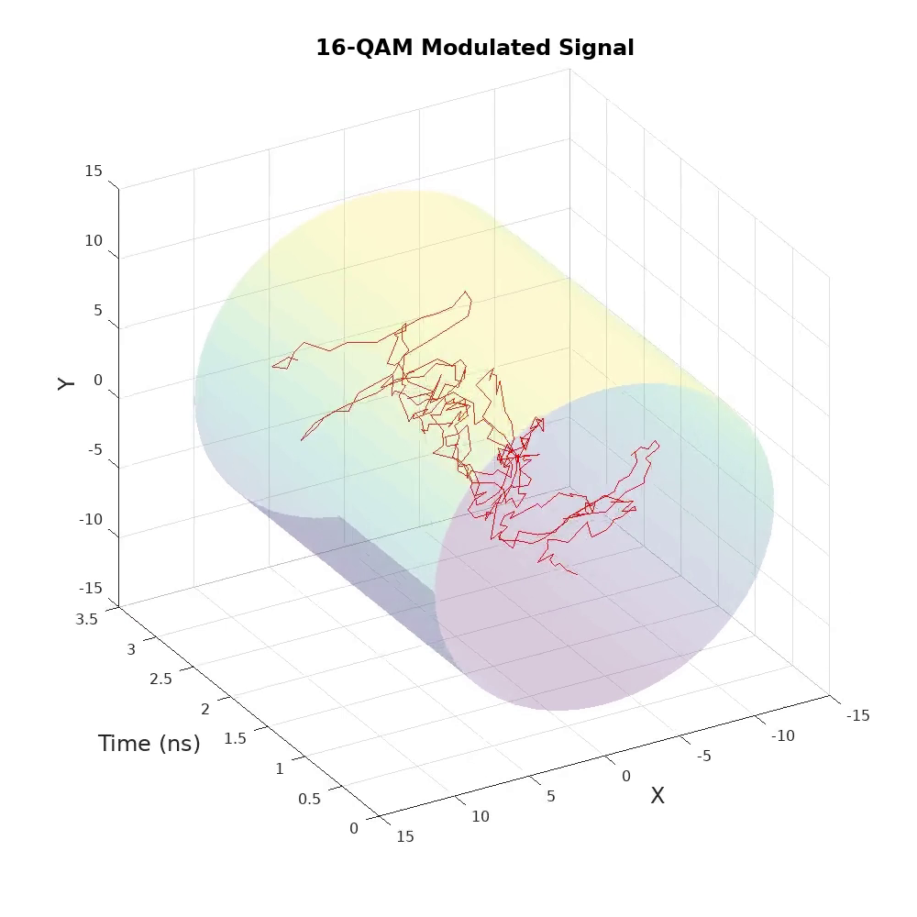
Polarisation Signal on X and Y Plane
Notes:
Slide only for presenter computer if no PowerPoint is available.

Slide 17
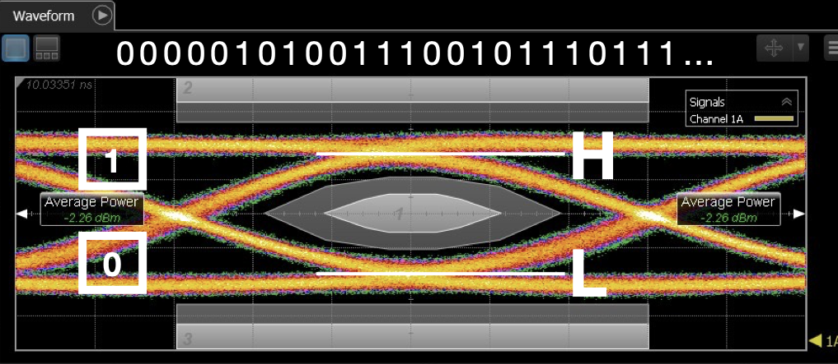
100G ecosystem limits ...
eye diagram does not cover phase

Slide 18
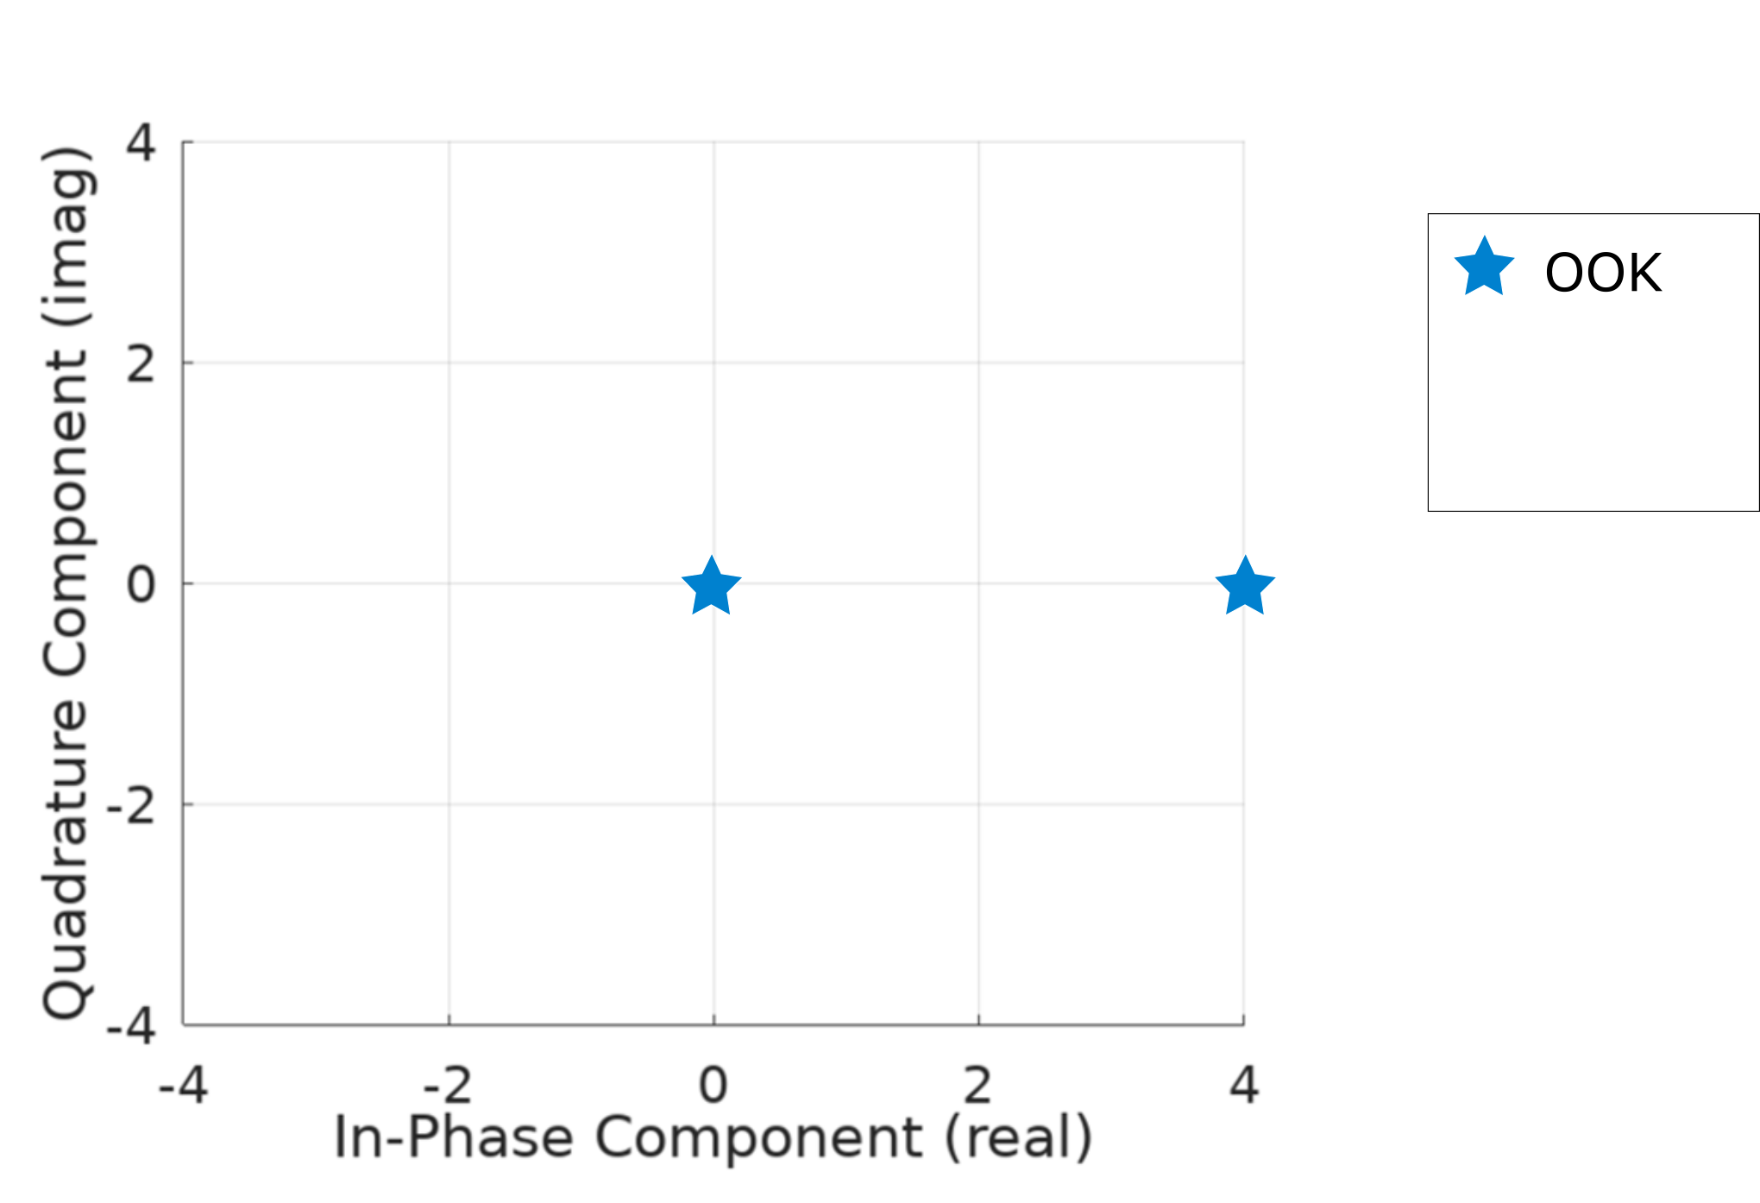
Constellation Diagramm
1 (on)
0 (off)
Notes:
Considering one plane (either X or Y), a constellation provides a better overview for signals with many phases - Instead of watching a time window, we just scatter for every symbol to the complex plane wherever it belongs.
+ Now we see the NZ (Return to Zero, an On-Off Keying variant) , which is not phase shifted, the values are kept on the In-Phase Axis

Slide 19
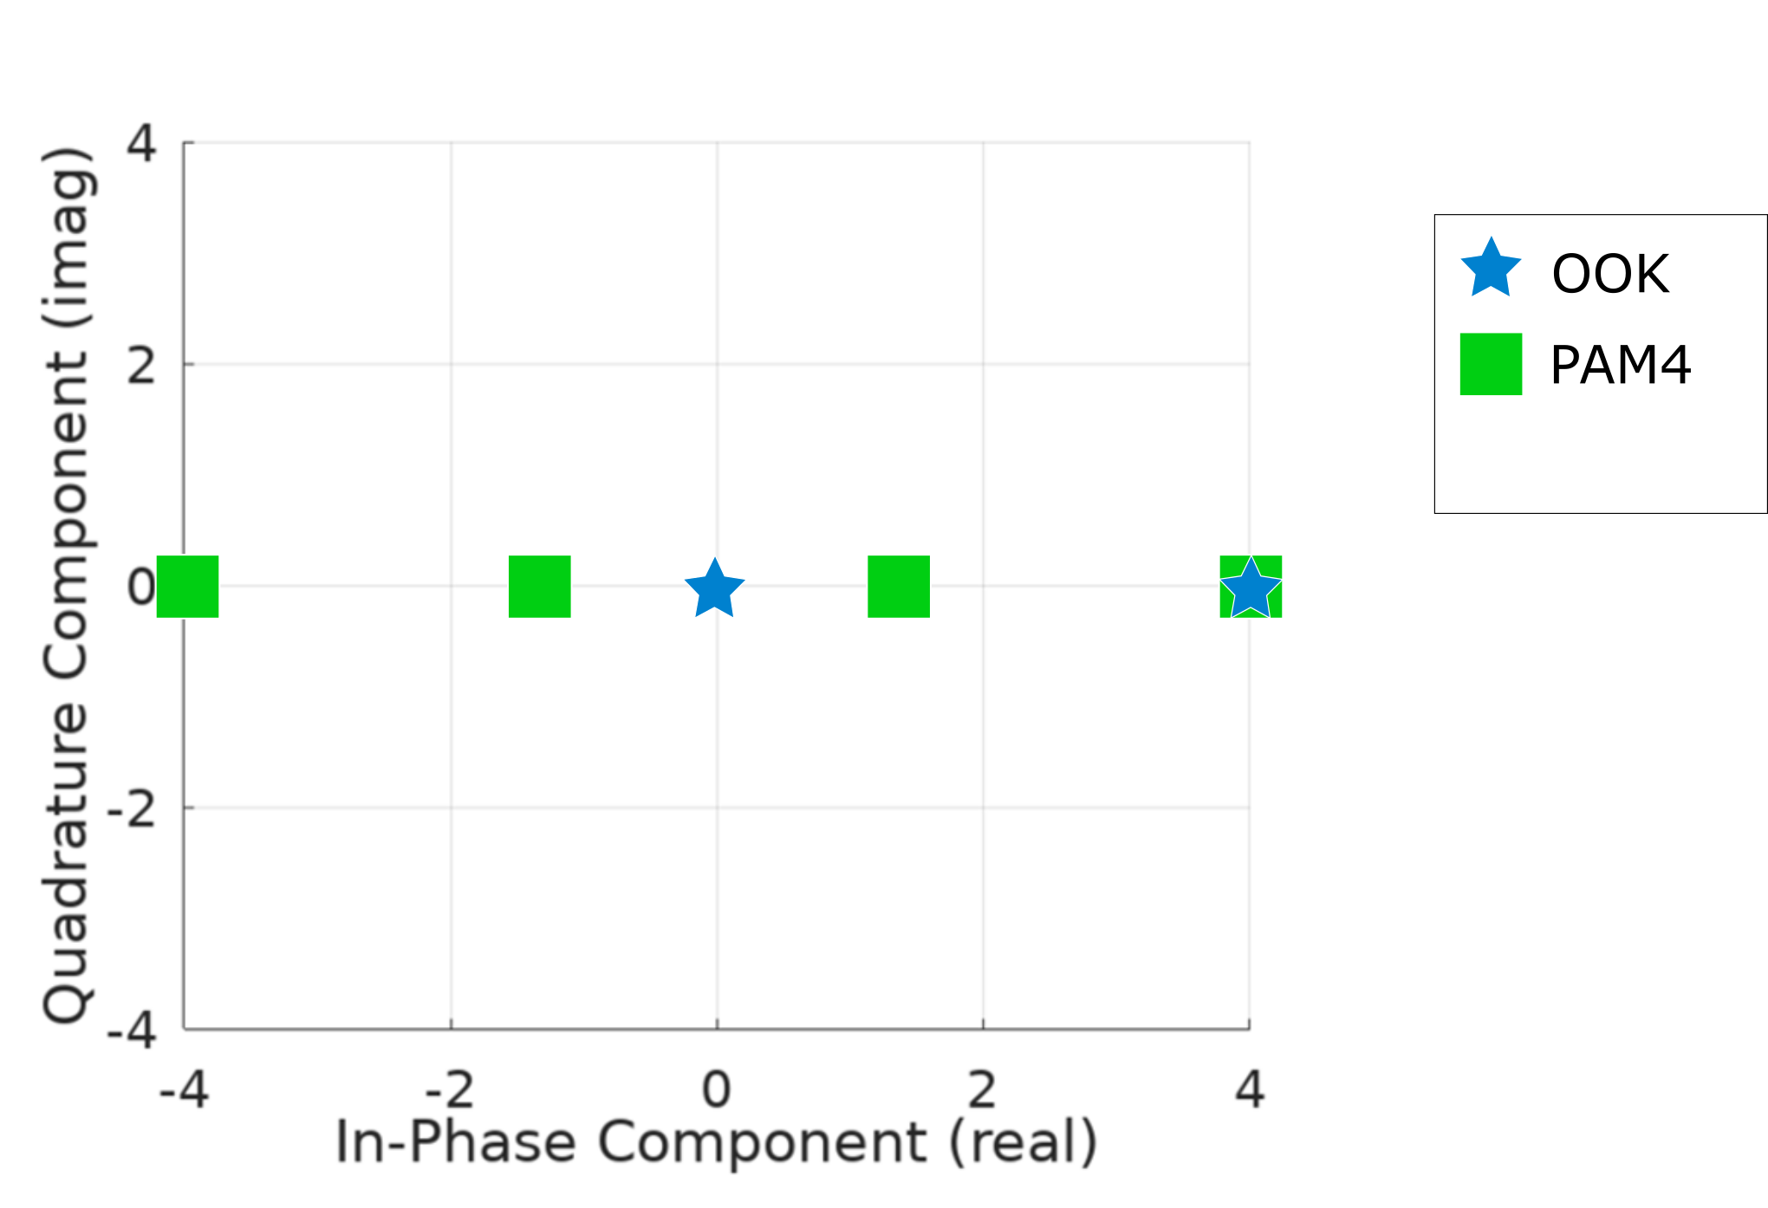
Constellation Diagramm
10
00
01
11
Notes:
Same situation with PAM-4 (Pulse Amplitude Modulation with 4 Levels, 2 bits/symbol) only has the In-Phase components (real), but no imaginary part

Slide 20
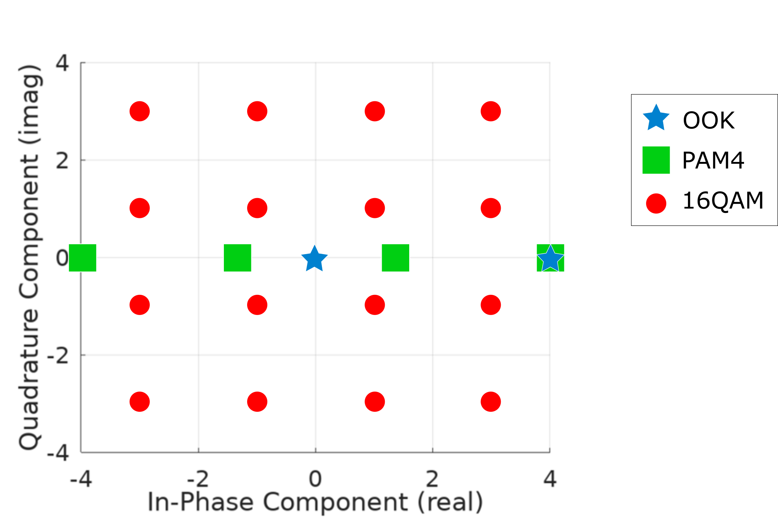
Constellation Diagramm
0010
0110
1110
1010
90° phase shifted amplitude
0011
0111
1111
1011
0001
0101
1101
1001
0000
0100
1100
1000
Notes:
+ And the 16 QAM (Quadrature Amplitude Modulation), 16 because 16 symbols. Talking about real and imaginary number, in terms of signal modulation we just use In-Phase (0 degrees) and Quadrature (90 degrees). As you can see in case of 16 QAM there always is an amplitude and phase angle given that belong to the given symbol. 16QAM: 4bit/symbol + amplitude measurement with two samples, shifted by ¼ Wavelength to get real and imaginary number; see optical rotary encoder as mechanical solution

Slide 21
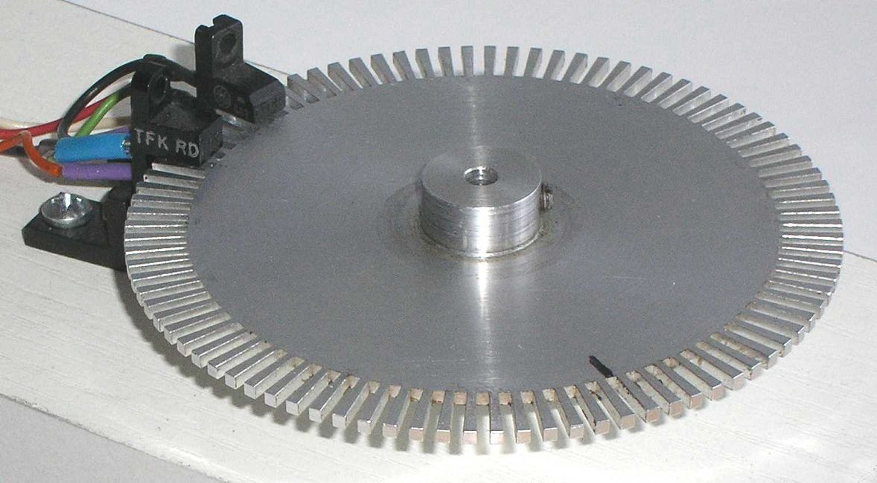
imaginary
real
90° phase shift
time
source: [9]
Notes:
+ Rotary optical encoder in the analog world to represent QAM, the slices in the disc encode 1s
+ Phase shift by 90° due position of the photo sensor and the corresponding frequency; the higher the frequency the closer both photo sensor need to be placed keeping the same phase shift of 90°
+ Advantage of two readers. You can detection whether the disc is clockwise or counter-clockwise rotating

Slide 22
imaginary
real
90° phase shift
time
real
imaginary
time
90°
source: [9]

Slide 23
real
imaginary
time
90°

Slide 24
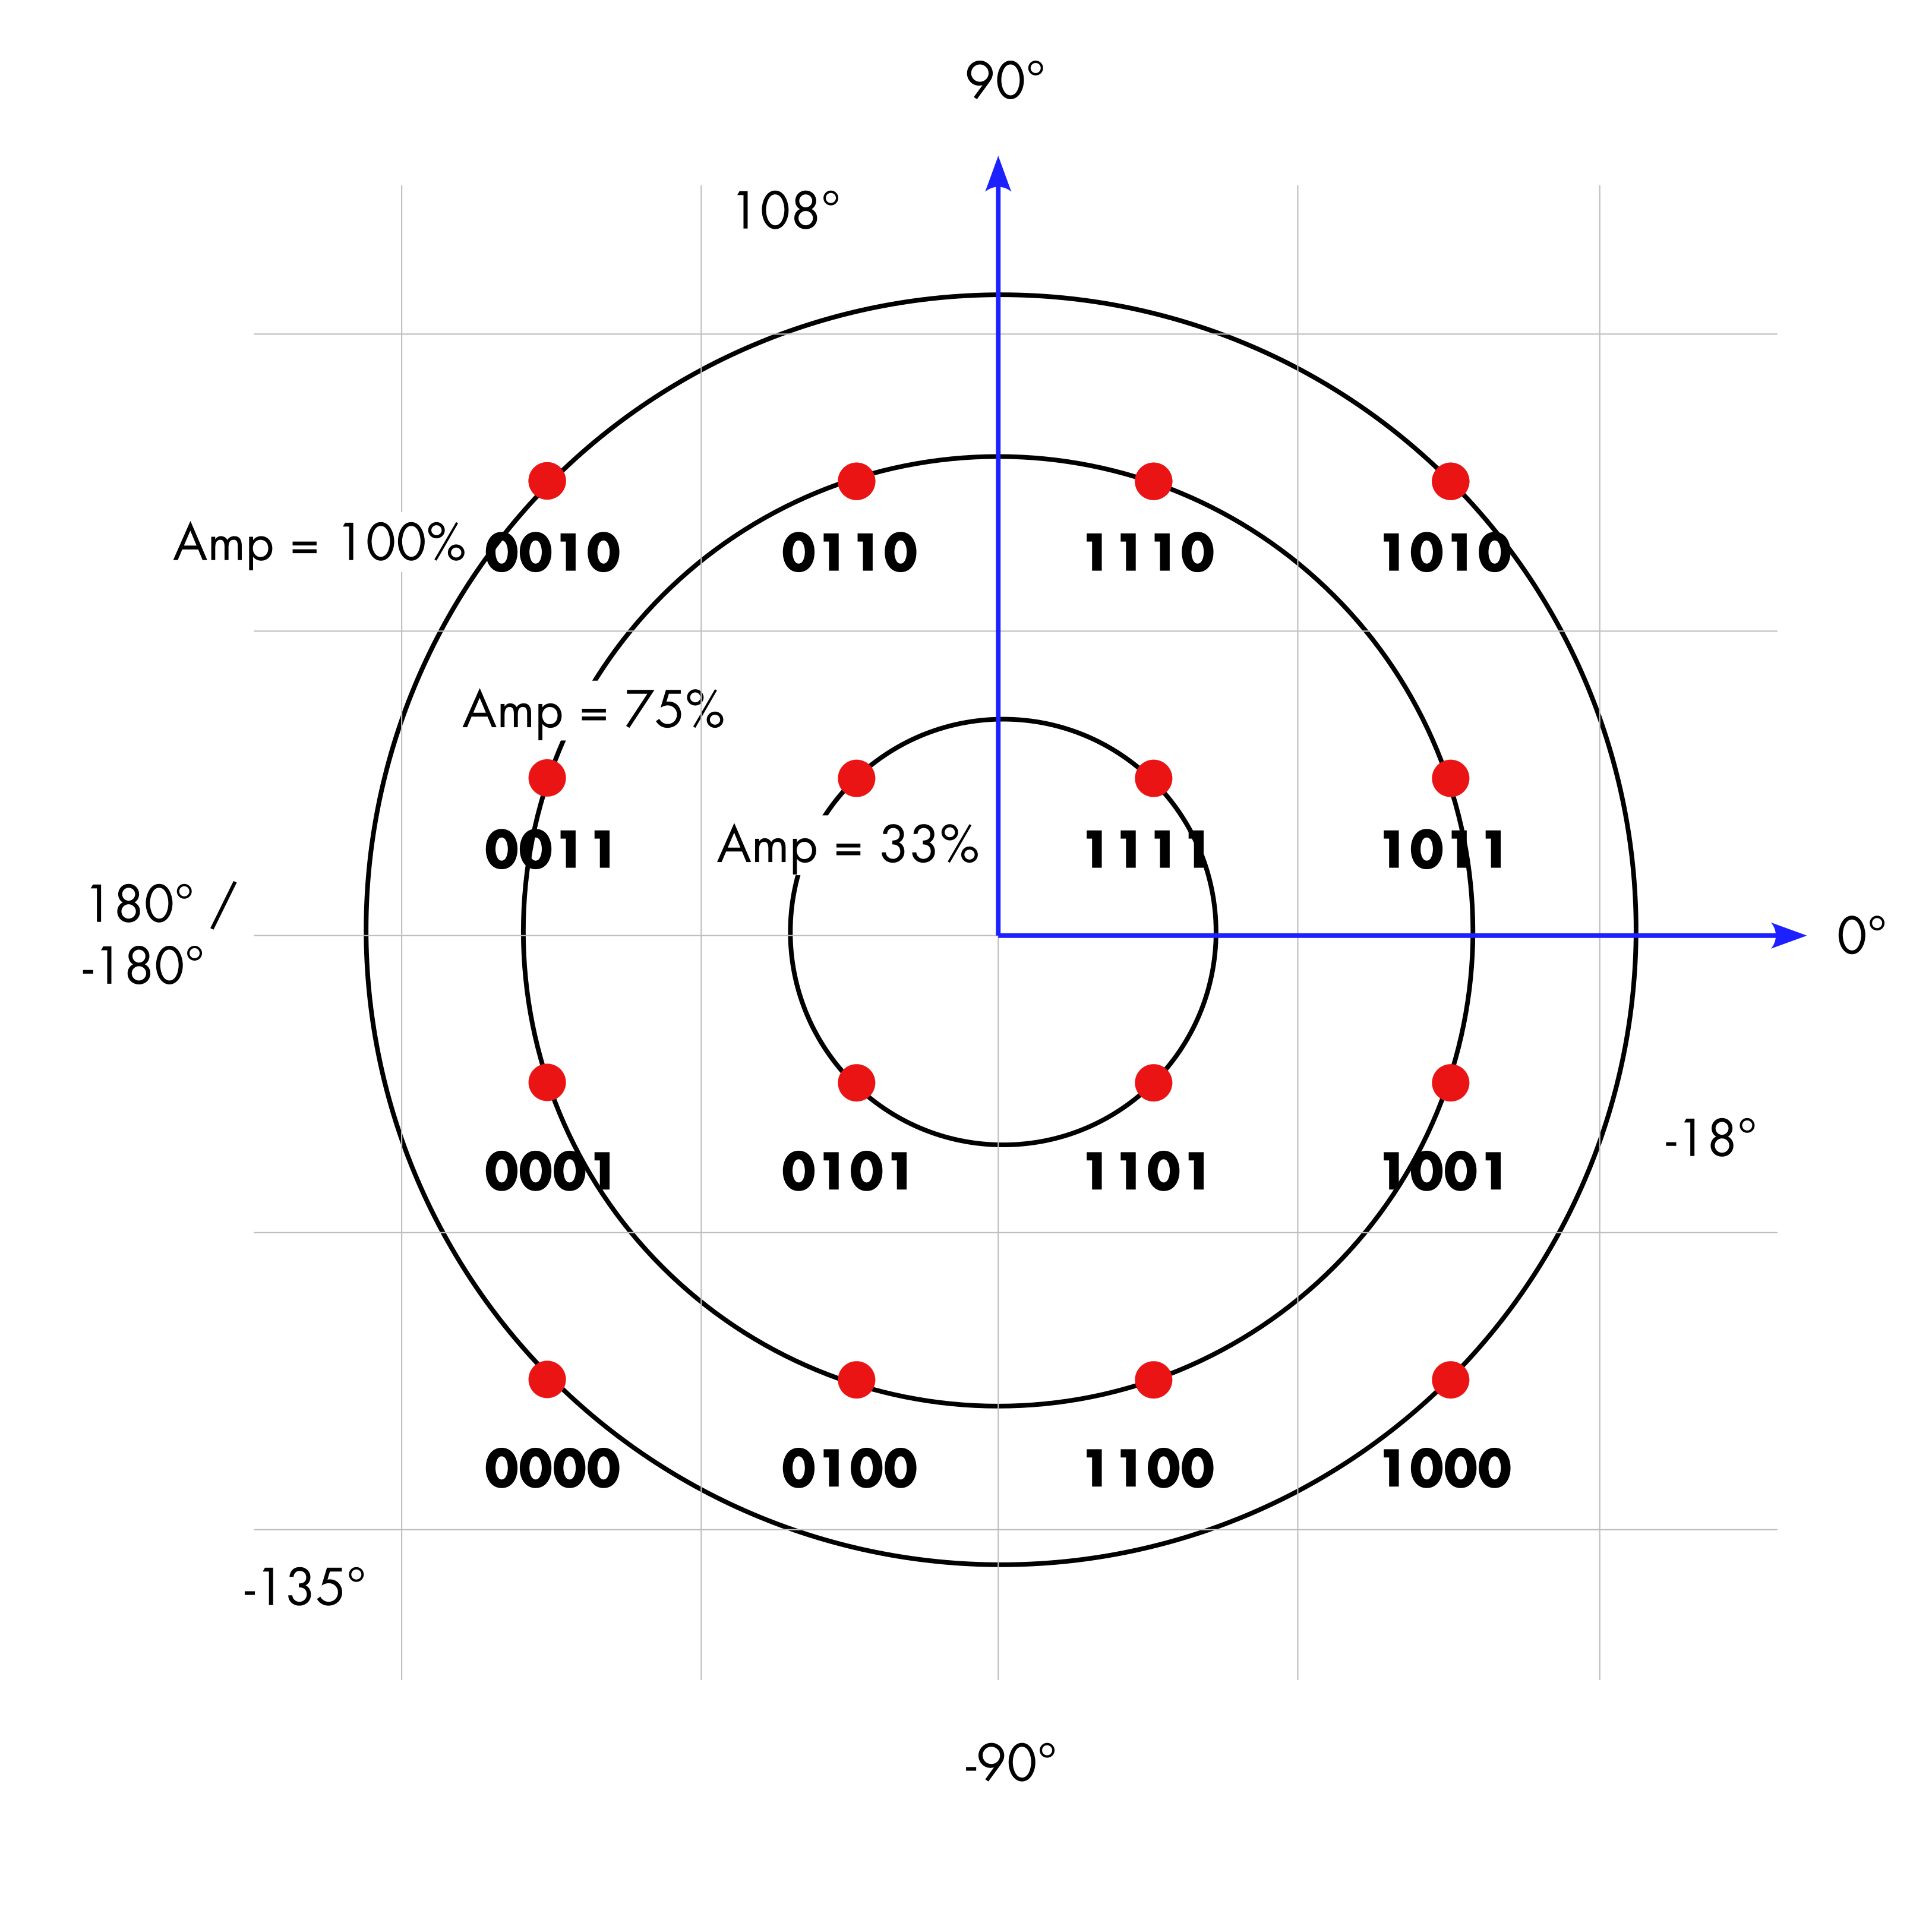
Phase =
Phase =
Phase =
Notes:
This is a detailed view on the 16-QAM constellation diagramm (for simplification just one polarization plane is shown)
1111 has Amp 33% and Phase +45°
0101 has Amp 33% and Phase –135°
0011 has Amp 75% and Phase +162°

Slide 25
Who is ? 1111 0101 0011
Phase =
Phase =
Phase =
Notes:
Full, Game:
1111 has Amp 33% and Phase +45°
0101 has Amp 33% and Phase –135°
0011 has Amp 75% and Phase +162°
There is the Red card, that describes the center
* Play cards with the audience * Sortierung von unten-rechts nach links-oben.
Everyone has a card. Let’s process 1001. Those who think that have the right card, please stand up.
IMPORTANT INSTRUCTIONS:
+ first of all, please ALL wave your cards
+ the center of the diagramm is the orange dot (Thomas, e.g.)
Okay, now let’s process 0000. Again please stand those who think that is there number.
Finally 0011. Please stand up.
Okay, I counted X people, Y were wrong. The BER is Y divided by X plus Y = Z
Here we go that is how the system may calculate the bit error ratio.

Slide 26
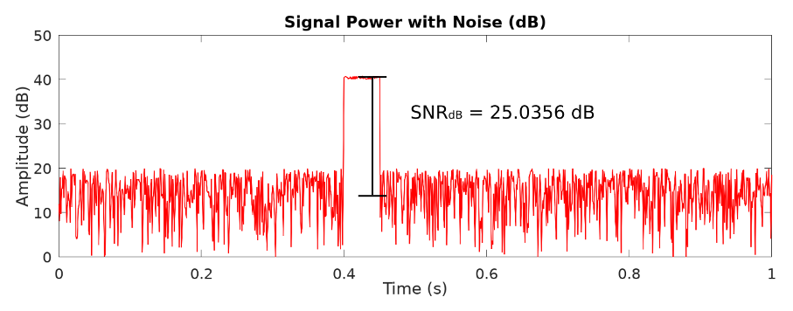
Measuring Signal Quality
SNR = Signal-to-Noise-Ratio
Convenience of using decibels for small and large values
(e)SNR vs OSNR:
electrical vs optical
Notes:
SNR is the ratio between the desired signal and the noise. Analog world example is a presentation. If the audience is quiet you can hear the speaker quite good, the SNR is quite high. If the audience is loud the SNR gets worse (e.g. also applies to a cheering soccer stadium)
For signal quality we define two properties from different worlds: + for people with focus on control circuits there is SNR: The higher the better (see the peak of the signal in the diagramm )
+ there is a relationship between the Bit Error Rate (BER)and SNR; SNR does influences how good or bad the BER will be at the end.

Slide 27
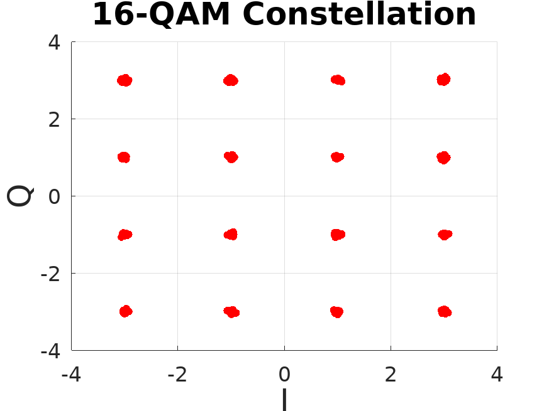
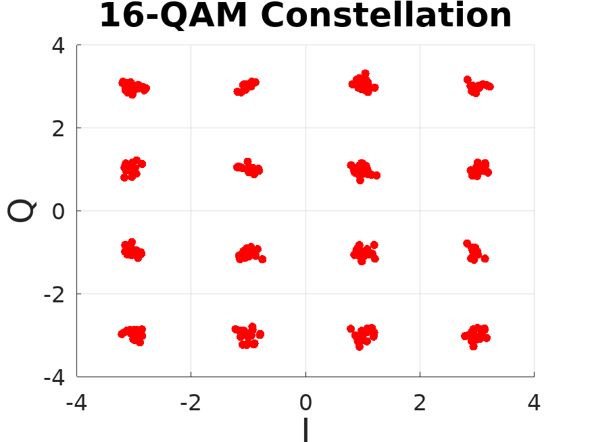
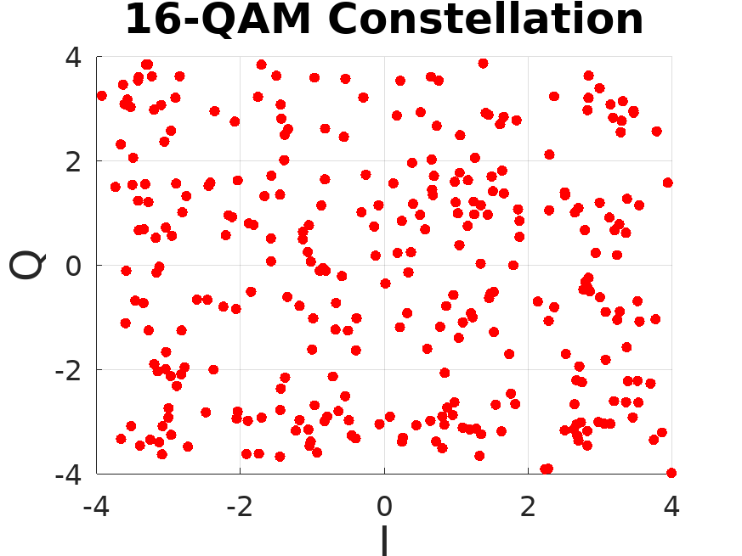
Phase and Amplitude Errors
SNR = 30 dB
SNR = 20 dB
SNR = 5 dB
NOTE: Polarisation Error not considered
Notes:
Comparing SNR values between 30, 20 and 5dB; you can clearly see which signal can still be recovered properly and which are properly lost.
Bit Error Ratio and SNR as correlated values to measure, but what more complex statistics. What for example if you want to know the error distribution of your probes. Standard deviation, median, mean values.

Slide 28
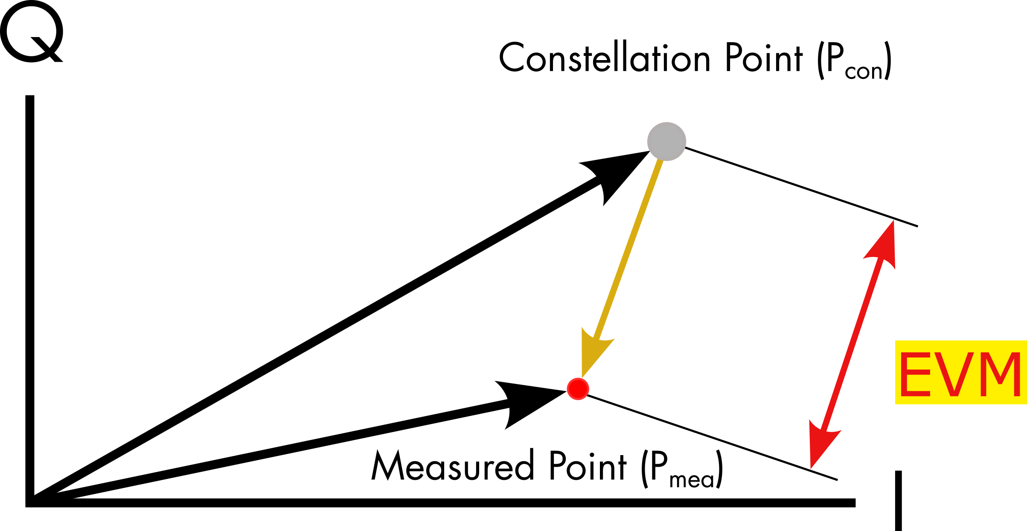
Error Vector Magnitude and Bit Error Rate
BER =$\frac{\# erroneous Bits}{\# xferred Bits}$
$EVM=\left|\vec{E_{V}}\right|=\left|\vec{P_{con}}−\vec{P_{mea}}\right|$
Notes:
full
With the Error Vector you have a two dimensional vector in the complex plane, where you can define its Quadrature and in-phase errors,
or if you care more for that because it is more interesting for you, you can also obtain the Phase and Magnitude (Amplitude) Error.
Many properties to consider, but for starters if you want to know how far away your measured to the ideal point is, the Error Vector Magnitude aka EVM tells you exactly that.
The EVM does apply especially for coherent transceivers, not for direct detection transceivers as there isn't a phase available.
Eventhough the EVM is much more complex and might provide further information compared to just SNR many devices do not support to show that feature currently.

Slide 29
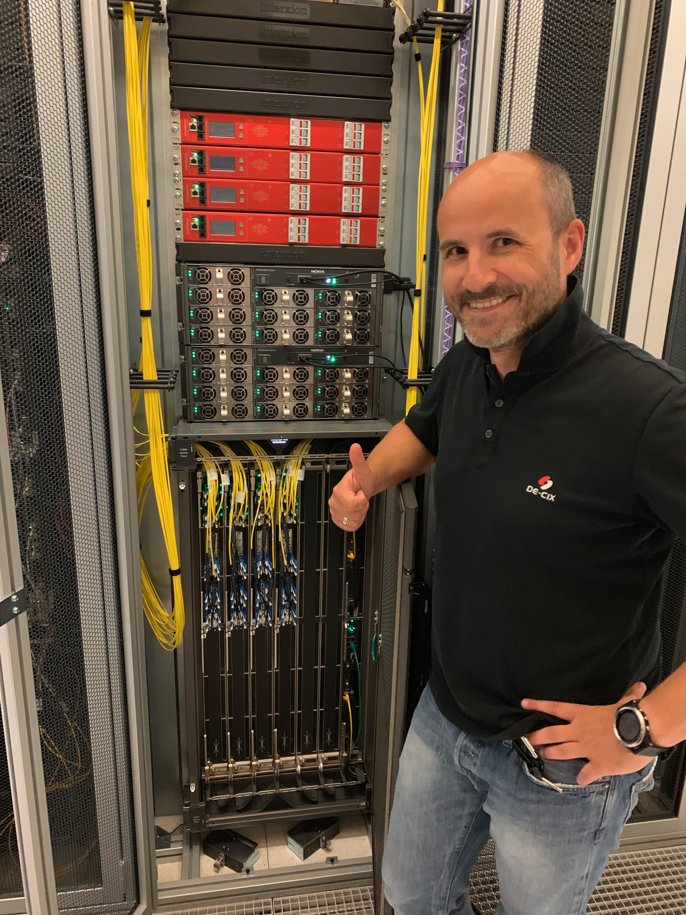
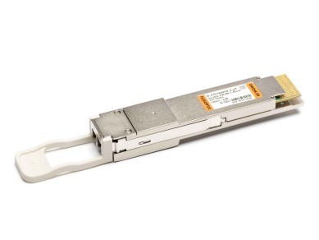
NOKIA SR-OS and 400G ZR Transceiver
terrific coherent workshop with
+
=
source:Daniel Melzer; DE-CIX
source: https://www.flexoptix.net/en/d-co164hg-2-yt.html
Notes:
together with Daniel Melzer from DE-CIX we did a great workshop understanding the Nokias CLI output – this was in October 2023

Slide 30
config with the CLI
Nokia 7950 XRS# show port 8/1/c7
===============================================================================
QSFP-DD Connector
===============================================================================
Description : -
Interface : 8/1/c7
FP Number : 2 MAC Chip Number : 3
...
Breakout : c1-400g
RS-FEC Config Mode : None
Transceiver Data
Transceiver Status : operational
Transceiver Type : QSFP-DD DCO : Enabled
Model Number : 3HE16564AARA01 NOK INUIAPHHAA
TX Laser Wavelength: 1558.983 nm Present Channel : 23
Configured Chann*: 23
Laser Tunability : flex-tunable
Config Freq (MHz) : 0 Min Freq(MHz): 191300000
Oper Freq(MHz) :192300000 Max Freq(MHz): 196100000
Fine Tune Range : 6000 MHz Fine Tune Resolu*: 1 MHz
Supported Grids: 100GHz 75GHz 50GHz 25GHz 12.5GHz 6.25GHz
Diag Capable : yes
Number of Lanes : 1
Connector Code : LC Vendor OUI : 20:20:20
Manufacture date : 2021/12/12 Media : Ethernet
...
.
Notes:
A fully tunable DWDM transceiver. Currently tuned at Channel 23 (192,30 THz)

Slide 31
analysis with the CLI
still show port 8/1/c7, DDM should be known by now
...
===============================================================================
Transceiver Digital Diagnostic Monitoring (DDM)
===============================================================================
Value High Alarm High Warn Low Warn Low Alarm
-------------------------------------------------------------------------------
Temperature(C) +48.0 +80.0 +75.0 +15.0 -5.0
Supply Voltage (V) 3.26 3.46 3.43 3.17 3.13
===============================================================================
===============================================================================
Transceiver Lane Digital Diagnostic Monitoring (DDM)
===============================================================================
High Alarm High Warn Low Warn Low Alarm
-------------------------------------------------------------------------------
Lane Tx Output Power (dBm) 0.00 -2.00 -13.00 -14.00
Lane Rx Optical Pwr (avg dBm) 2.00 0.00 -21.02 -23.01
-------------------------------------------------------------------------------
Lane ID Temp(C)/Alm Tx Bias(mA)/Alm Tx Pwr(dBm)/Alm Rx Pwr(dBm)/Alm
-------------------------------------------------------------------------------
1 - - -8.20 0.01/H-W
===============================================================================
...
Notes:
DDM should be implemented by now and your NMS is capturing this data
Monitor the temperature – refer to "unsupported" platforms as such a transceiver can draw up to 17 Watt per port. With 30 ports you end up with roughly 500 Watts for the optical transmission.

Slide 32
analysis with the CLI
still show port 8/1/c7, DDM should be known by now
...
===============================================================================
Transceiver Digital Diagnostic Monitoring (DDM)
===============================================================================
Value High Alarm High Warn Low Warn Low Alarm
-------------------------------------------------------------------------------
Temperature(C) +48.0 +80.0 +75.0 +15.0 -5.0
Supply Voltage (V) 3.26 3.46 3.43 3.17 3.13
===============================================================================
===============================================================================
Transceiver Lane Digital Diagnostic Monitoring (DDM)
===============================================================================
High Alarm High Warn Low Warn Low Alarm
-------------------------------------------------------------------------------
Lane Tx Output Power (dBm) 0.00 -2.00 -13.00 -14.00
Lane Rx Optical Pwr (avg dBm) 2.00 0.00 -21.02 -23.01
-------------------------------------------------------------------------------
Lane ID Temp(C)/Alm Tx Bias(mA)/Alm Tx Pwr(dBm)/Alm Rx Pwr(dBm)/Alm
-------------------------------------------------------------------------------
1 - - -8.20 0.01/H-W
===============================================================================
...
heat
16,999 W
power
17 W
light
0,001 W
Notes:
Only a very small portion of the electrical energy is used for the optical side. The major part is converted into heat, as this simple Sankey Diagram shows

Slide 33
the interesting part
still show port 8/1/c7, now it becomes tricky
...
===============================================================================
Coherent Optical Module
===============================================================================
Cfg Tx Target Power: 1.00 dBm Present Rx Channel : 23
Cfg Rx LOS Thresh : -23.00 dBm Cfg Rx Channel : 23
Disp Control Mode : automatic Sweep Start Disp : -25500 ps/nm
Cfg Dispersion : 0 ps/nm Sweep End Disp : 2000 ps/nm
CPR Window Size : 32 symbols Rx LOS Reaction : squelch
Compatibility : openZrpOfec1
Cfg Tx Power Min : -22.90 dBm Cfg Tx Power Max : 4.00 dBm
Cfg Alarms : modflt mod netrx nettx hosttx
Alarm Status :
Defect Points :
Rx Q Margin : 2.4 dB Chromatic Disp : 220 ps/nm
SNR/OSNR X Polar : 17.4 dB / 34.4 dB Diff Group Delay : 2 ps
SNR/OSNR Y Polar : 17.4 dB / 34.4 dB Pre-FEC BER : 1.213E-03
Module State : ready
Tx Turn-Up States : init laserTurnUp laserReadyOff laserReady
modulatorConverge outputPowerAdjust
Rx Turn-Up States : init laserReady waitForInput adcSignal opticalLock
demodLock
===============================================================================
Notes:
these are the coherent specific parameters in the CLI

Slide 34
RX Channel
still show port 8/1/c7, the receiver requires its own laser
...
===============================================================================
Coherent Optical Module
===============================================================================
Cfg Tx Target Power: 1.00 dBm Present Rx Channel : 23
Cfg Rx LOS Thresh : -23.00 dBm Cfg Rx Channel : 23
Disp Control Mode : automatic Sweep Start Disp : -25500 ps/nm
Cfg Dispersion : 0 ps/nm Sweep End Disp : 2000 ps/nm
CPR Window Size : 32 symbols Rx LOS Reaction : squelch
Compatibility : openZrpOfec1
Cfg Tx Power Min : -22.90 dBm Cfg Tx Power Max : 4.00 dBm
Cfg Alarms : modflt mod netrx nettx hosttx
Alarm Status :
Defect Points :
Rx Q Margin : 2.4 dB Chromatic Disp : 220 ps/nm
SNR/OSNR X Polar : 17.4 dB / 34.4 dB Diff Group Delay : 2 ps
SNR/OSNR Y Polar : 17.4 dB / 34.4 dB Pre-FEC BER : 1.213E-03
Module State : ready
Tx Turn-Up States : init laserTurnUp laserReadyOff laserReady
modulatorConverge outputPowerAdjust
Rx Turn-Up States : init laserReady waitForInput adcSignal opticalLock
demodLock
===============================================================================
required to establish the link, no sweeping
Notes:
+ center frequence of the Optical Local Oscillator (OLO). The OLO is a laser – either a dedicated one or taken from TX. This is required to gather the desired signal from the carrier
+ this is a new approach. In the past with 10G tunable DWDM only TX required tuning – RX took basically "all".
+ if only one OLO is used für TX and RX then their frequency need to be the same, just because of physics as this shared source (the OLO) is splitted via an optical splitter. As a result of this single strand links are not possible!

Slide 35
Chromatic Dispersion (CD)
still show port 8/1/c7, back in the past with 10G and CWDM this was a major issue
...
===============================================================================
Coherent Optical Module
===============================================================================
Cfg Tx Target Power: 1.00 dBm Present Rx Channel : 23
Cfg Rx LOS Thresh : -23.00 dBm Cfg Rx Channel : 23
Disp Control Mode : automatic Sweep Start Disp:-25500 ps/nm
Cfg Dispersion : 0 ps/nm Sweep End Disp : 2000 ps/nm
CPR Window Size : 32 symbols Rx LOS Reaction : squelch
Compatibility : openZrpOfec1
Cfg Tx Power Min : -22.90 dBm Cfg Tx Power Max : 4.00 dBm
Cfg Alarms : modflt mod netrx nettx hosttx
Alarm Status :
Defect Points :
Rx Q Margin : 2.4 dB Chromatic Disp : 220 ps/nm
SNR/OSNR X Polar : 17.4 dB / 34.4 dB Diff Group Delay : 2 ps
SNR/OSNR Y Polar : 17.4 dB / 34.4 dB Pre-FEC BER : 1.213E-03
Module State : ready
Tx Turn-Up States : init laserTurnUp laserReadyOff laserReady
modulatorConverge outputPowerAdjust
Rx Turn-Up States : init laserReady waitForInput adcSignal opticalLock
demodLock
===============================================================================
If Disp Control Mode is manual: Configure a target dispersion, where the switch may decide whether to raise warnings or not.
Sweep: With start and end you indicate a range of allowed dispersion that can be handled by a compensator (DSP in this case)
Notes:
+ CD is the change of the variance while the signal (propagation speed is either decelerated or accelerated) is traversing the fiber. Very well known back in the days when operating 10G CWDM networks. 1310nm window (O-band) was not an issue but longer wavelength in the L-Band arround 1610nm had significant issues with CD on longer spans.
+ take white light hitting a prism in the analog world there you even can see dispersion
+ the DSP can sweep through a certain range and identify / measure the propagation swift / chromatic dispersion
+ the CLI output is based on a 15km of fiber span (10ps/nm/km) - some offset of 70-80ps/nm (still unknown where they are coming from as they are showed even at a back-to-back link which has 0ps/nm)

Slide 36
Polarisation Mode Dispersion (PMD)
still show port 8/1/c7, don't be to late
...
===============================================================================
Coherent Optical Module
===============================================================================
Cfg Tx Target Power: 1.00 dBm Present Rx Channel : 23
Cfg Rx LOS Thresh : -23.00 dBm Cfg Rx Channel : 23
Disp Control Mode : automatic Sweep Start Disp : -25500 ps/nm
Cfg Dispersion : 0 ps/nm Sweep End Disp : 2000 ps/nm
CPR Window Size : 32 symbols Rx LOS Reaction : squelch
Compatibility : openZrpOfec1
Cfg Tx Power Min : -22.90 dBm Cfg Tx Power Max : 4.00 dBm
Cfg Alarms : modflt mod netrx nettx hosttx
Alarm Status :
Defect Points :
Rx Q Margin : 2.4 dB Chromatic Disp : 220 ps/nm
SNR/OSNR X Polar : 17.4 dB / 34.4 dB Diff Group Delay: 2 ps
SNR/OSNR Y Polar : 17.4 dB / 34.4 dB Pre-FEC BER : 1.213E-03
Module State : ready
Tx Turn-Up States : init laserTurnUp laserReadyOff laserReady
modulatorConverge outputPowerAdjust
Rx Turn-Up States : init laserReady waitForInput adcSignal opticalLock
demodLock
===============================================================================
Difference in propagation time for X and Y polarisation
Notes:
+ DGD is a characteristic of the fiber and influences the two polarziations (X and Y).
+ typically a QSFP-DD 400G OIF 400ZR can compensate up to 10ps. Please check its datasheet.

Slide 37
Notes:
full migrant birds towards the south – Foto taken Friday, 17.11.2023 around our headquarter by Thomas

Slide 38
who is the pilot this morning ?
Notes:
full

Slide 39
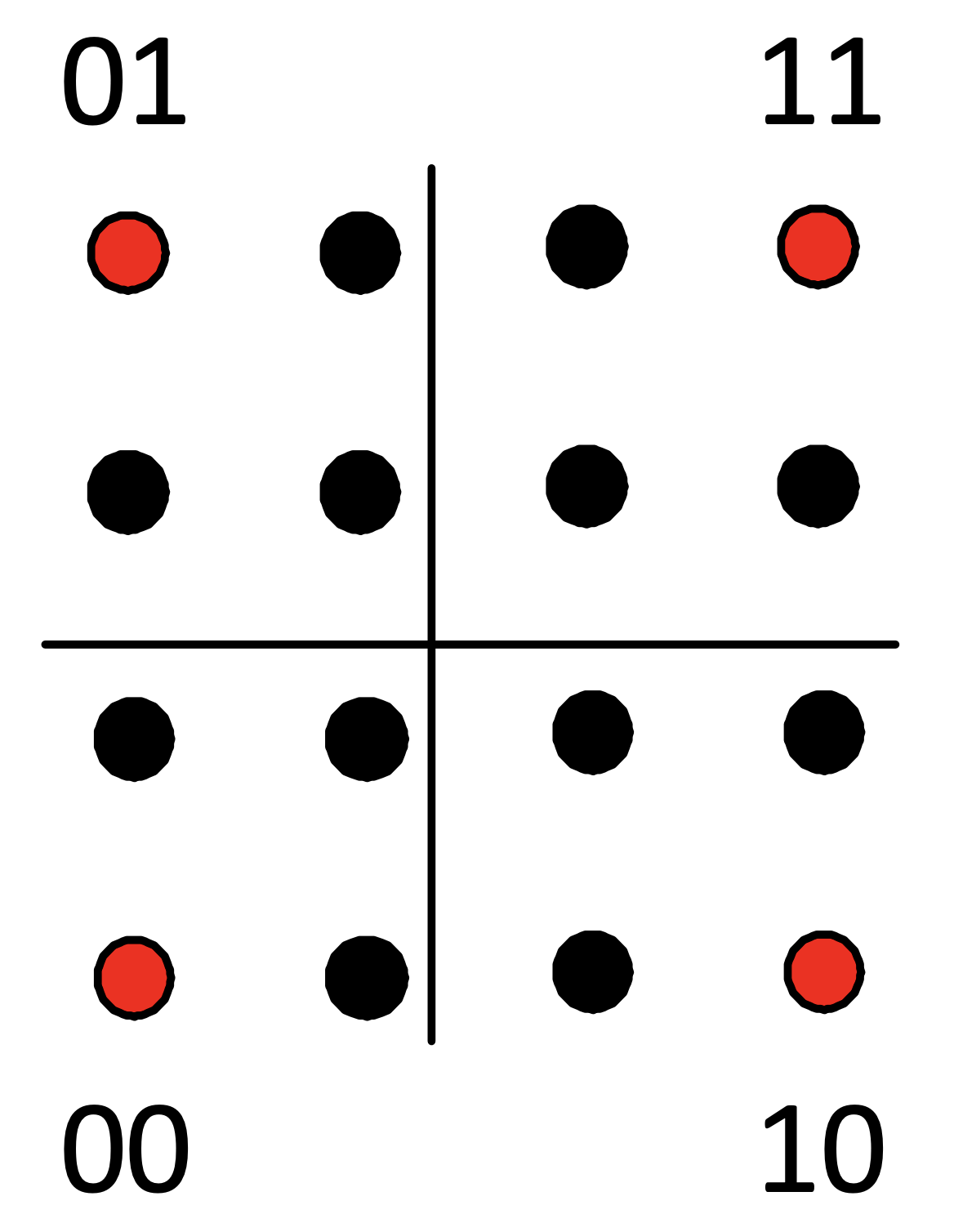
Carrier Phase Recovery (CPR)
still show port 8/1/c7, we got 4 pilots
...
===============================================================================
Coherent Optical Module
===============================================================================
Cfg Tx Target Power: 1.00 dBm Present Rx Channel : 23
Cfg Rx LOS Thresh : -23.00 dBm Cfg Rx Channel : 23
Disp Control Mode : automatic Sweep Start Disp : -25500 ps/nm
Cfg Dispersion : 0 ps/nm Sweep End Disp : 2000 ps/nm
CPR Window Size: 32 symbols Rx LOS Reaction : squelch
Compatibility : openZrpOfec1
Cfg Tx Power Min : -22.90 dBm Cfg Tx Power Max : 4.00 dBm
Cfg Alarms : modflt mod netrx nettx hosttx
Alarm Status :
Defect Points :
Rx Q Margin : 2.4 dB Chromatic Disp : 220 ps/nm
SNR/OSNR X Polar : 17.4 dB / 34.4 dB Diff Group Delay : 2 ps
SNR/OSNR Y Polar : 17.4 dB / 34.4 dB Pre-FEC BER : 1.213E-03
Module State : ready
Tx Turn-Up States : init laserTurnUp laserReadyOff laserReady
modulatorConverge outputPowerAdjust
Rx Turn-Up States : init laserReady waitForInput adcSignal opticalLock
demodLock
===============================================================================
Pilot Sequence: Signal for verification and recovery (rotated 16QAM f.e.) with using QPSK (Quadrature Phase Shift Keying), the red dots.
source: [5]
Notes:
full small window sizes have more phase-noise; big window sizes end up in more latency until a disruption (a phase shift or interruption) will be recognized and the correct phase is locked again.
phase shifts can occur due lightning strike

Slide 40
Signal-to-Noise Ratio (SNR)
still show port 8/1/c7, almost done
...
===============================================================================
Coherent Optical Module
===============================================================================
Cfg Tx Target Power: 1.00 dBm Present Rx Channel : 23
Cfg Rx LOS Thresh : -23.00 dBm Cfg Rx Channel : 23
Disp Control Mode : automatic Sweep Start Disp : -25500 ps/nm
Cfg Dispersion : 0 ps/nm Sweep End Disp : 2000 ps/nm
CPR Window Size : 32 symbols Rx LOS Reaction : squelch
Compatibility : openZrpOfec1
Cfg Tx Power Min : -22.90 dBm Cfg Tx Power Max : 4.00 dBm
Cfg Alarms : modflt mod netrx nettx hosttx
Alarm Status :
Defect Points :
Rx Q Margin : 2.4 dB Chromatic Disp : 220 ps/nm
OSNR X Polar: 34.4 dB Diff Group Delay : 2 ps
OSNR Y Polar: 34.4 dB Pre-FEC BER: 1.213E-03
Module State : ready
Tx Turn-Up States : init laserTurnUp laserReadyOff laserReady
modulatorConverge outputPowerAdjust
Rx Turn-Up States : init laserReady waitForInput adcSignal opticalLock
demodLock
OSNR: check datasheet, depends on application mode
Q Margin (Q Factor): gap between the current pre-FEC BER value and error-free threshold in dB
Notes:
+ Rx Q Margin is defined by Nokia. Industry calls it Q Factor
+ Typical OIF 400ZR transceiver can handle OSNR of up to 26dB
+ a back-to-back look like this: Rx Q Margin : 4.1 dB Chromatic Disp : 80 ps/nm SNR/OSNR X Polar : 28.2 dB / 29.7 dB Diff Group Delay : 3 ps SNR/OSNR Y Polar : 28.2 dB / 29.7 dB Pre-FEC BER : 5.180E-04
+ Error Vector Magnitude:
1. EVM (error vector magnitude; the intuitive approach of taking the distance of a measured point from the closest ideal constellation point.)
2. SNR (von EVM abgeleitet, auch MER genannt)
3. BER (vorhergesagt durch EVM)

Slide 41
Compatibility / Application Mode
still show port 8/1/c7, !??
...
===============================================================================
Coherent Optical Module
===============================================================================
Cfg Tx Target Power: 1.00 dBm Present Rx Channel : 23
Cfg Rx LOS Thresh : -23.00 dBm Cfg Rx Channel : 23
Disp Control Mode : automatic Sweep Start Disp : -25500 ps/nm
Cfg Dispersion : 0 ps/nm Sweep End Disp : 2000 ps/nm
CPR Window Size : 32 symbols Rx LOS Reaction : squelch
Compatibility: openZrpOfec1
Cfg Tx Power Min : -22.90 dBm Cfg Tx Power Max : 4.00 dBm
Cfg Alarms : modflt mod netrx nettx hosttx
Alarm Status :
Defect Points :
Rx Q Margin : 2.4 dB Chromatic Disp : 220 ps/nm
SNR/OSNR X Polar : 17.4 dB / 34.4 dB Diff Group Delay : 2 ps
SNR/OSNR Y Polar : 17.4 dB / 34.4 dB Pre-FEC BER : 1.213E-03
Module State : ready
Tx Turn-Up States : init laserTurnUp laserReadyOff laserReady
modulatorConverge outputPowerAdjust
Rx Turn-Up States : init laserReady waitForInput adcSignal opticalLock
demodLock
===============================================================================
Application Mode | MSA format | Nokia Compatibility | Host format | Nokia Config | Electrical interface | FEC | Modulation | Line Symbol Baud Rate
1 | OIF 400ZR, amplified | oif-400g-zr | 400GBASE-R | c1-400g | 1x 400GAUI-8 (8x 50G) | CFEC | DP-16QAM | 59.8GBd
2 | OIF 400ZR, unamplified |  | 400GBASE-R |  | 1x 400GAUI-8 (8x 50G) | CFEC | DP-16QAM | 59.8GBd
3 | OpenZR+ MSA | openZrpOfec1 | 400GBASE-R | c1-400g | 1x 400GAUI-8 (8x 50G) | oFEC | DP-16QAM | 60.1GBd
4 | OpenZR+ MSA |  | 2x 200GBASE-R |  | 2x 200GAUI-4 (4x 50G) | oFEC | DP-16QAM | 60.1GBd
5 | OpenZR+ MSA | openZrpOfec1 | 4x 100GBASE-R | c4-100g | 4x 100GAUI-2 (2x 50G) | oFEC | DP-16QAM | 60.1GBd
6 | OpenZR+ MSA, Enhanced | openZrpOfec2 | 400GBASE-R | c1-400g | 1x 400GAUI-8 (8x 50G) | oFEC | DP-16QAM | 60.1GBd
7 | OpenZR+ MSA, Enhanced |  | 2x 200GBASE-R |  | 2x 200GAUI-4 (4x 50G) | oFEC | DP-16QAM | 60.1GBd
8 | OpenZR+ MSA, Enhanced | openZrpOfec2 | 4x 100GBASE-R | c4-100g | 4x 100GAUI-2 (2x 50G) | oFEC | DP-16QAM | 60.1GBd
9 | OpenZR+ MSA | openZrpOfec1 | 2x 100GBASE-R | c2-100g-aui2 | 2x 100GAUI-2 (2x 50G) | oFEC | DP-QPSK | 60.1GBd
10 | OpenZR+ MSA | openZrpOfec2 | 1x 100GBASE-R | c1-100g-aui2 | 1x 100GAUI-2 (2x 50G) | oFEC | DP-QPSK | 30.1GBd
11 | OpenZR+ MSA | openZrpOfec1 | 3x 100GBASE-R | c3-100g | 3x 100GAUI-2 (2x 50G) | oFEC | DP-8QAM | 60.1GBd
12 | OpenZR+ MSA, Enhanced |  | 3x 100GBASE-R |  | 3x 100GAUI-2 (2x 50G) | oFEC | DP-8QAM | 60.1GBd
13 | OIF 400ZR, amplified | oif-400g-zr | 4x 100GBASE-R | c4-100g | 4x 100GAUI-2 (2x 50G) | CFEC | DP-16QAM | 59.8GBd
14 | OpenZR+ MSA, Enhanced | openZrpOfec2 | 2x 100GBASE-R | c2-100g-aui2 | 2x 100GAUI-2 (2x50G) | oFEC | DP-16QAM | 30.1GBd
15 | OpenZR+ MSA |  | 100GBASE-R |  | 1x CAUI-4 w/o FEC (4x25G) | oFEC | DP-QPSK | 30.1GBd
Notes:
+ SR-OS23.10.R1: openZrpOfec1 (according Nokia CLI reference guide it is called "open-zr-ofec1"
+ a 400G coherent transceiver does support more than just plain 400G; there are so called "application modes" and you can choose between 10 – 15 different application modes, e.g. 2 x 200G or 4 x 100G operations. This depends on the DSPs firmware capabilities and implementation.

Slide 42
Compatibility / Application Mode
still show port 8/1/c7, !??
...
===============================================================================
Coherent Optical Module
===============================================================================
Cfg Tx Target Power: 1.00 dBm Present Rx Channel : 23
Cfg Rx LOS Thresh : -23.00 dBm Cfg Rx Channel : 23
Disp Control Mode : automatic Sweep Start Disp : -25500 ps/nm
Cfg Dispersion : 0 ps/nm Sweep End Disp : 2000 ps/nm
CPR Window Size : 32 symbols Rx LOS Reaction : squelch
Compatibility: openZrpOfec1
Cfg Tx Power Min : -22.90 dBm Cfg Tx Power Max : 4.00 dBm
Cfg Alarms : modflt mod netrx nettx hosttx
Alarm Status :
Defect Points :
Rx Q Margin : 2.4 dB Chromatic Disp : 220 ps/nm
SNR/OSNR X Polar : 17.4 dB / 34.4 dB Diff Group Delay : 2 ps
SNR/OSNR Y Polar : 17.4 dB / 34.4 dB Pre-FEC BER : 1.213E-03
Module State : ready
Tx Turn-Up States : init laserTurnUp laserReadyOff laserReady
modulatorConverge outputPowerAdjust
Rx Turn-Up States : init laserReady waitForInput adcSignal opticalLock
demodLock
===============================================================================
Nokia 7950 XRS# show port 8/1/c7
==============================================
QSFP-DD Connector
==============================================
Description : -
Interface : 8/1/c7
FP Number : 2
...
Breakout : c1-400g
RS-FEC Config Mode : None
Transceiver Data
...
Laser Tunability : flex-tunable
Config Freq (MHz) : 0
Oper Freq (MHz) : 192300000
Fine Tune Range : 6000 MHz
Supported Grids : 100GHz 75GHz 50GHz 25GHz
...
Optical Compliance: 400G-ZR-Amp 400G-ZR-Unamp
Link Length support: Unknown
...
.
Application Mode | MSA format | Nokia Compatibility | Host format | Nokia Config | Electrical interface | FEC | Modulation | Line Symbol Baud Rate
1 | OIF 400ZR, amplified | oif-400g-zr | 400GBASE-R | c1-400g | 1x 400GAUI-8 (8x 50G) | CFEC | DP-16QAM | 59.8GBd
2 | OIF 400ZR, unamplified |  | 400GBASE-R |  | 1x 400GAUI-8 (8x 50G) | CFEC | DP-16QAM | 59.8GBd
3 | OpenZR+ MSA | openZrpOfec1 | 400GBASE-R | c1-400g | 1x 400GAUI-8 (8x 50G) | oFEC | DP-16QAM | 60.1GBd
4 | OpenZR+ MSA |  | 2x 200GBASE-R |  | 2x 200GAUI-4 (4x 50G) | oFEC | DP-16QAM | 60.1GBd
5 | OpenZR+ MSA | openZrpOfec1 | 4x 100GBASE-R | c4-100g | 4x 100GAUI-2 (2x 50G) | oFEC | DP-16QAM | 60.1GBd
6 | OpenZR+ MSA, Enhanced | openZrpOfec2 | 400GBASE-R | c1-400g | 1x 400GAUI-8 (8x 50G) | oFEC | DP-16QAM | 60.1GBd
7 | OpenZR+ MSA, Enhanced |  | 2x 200GBASE-R |  | 2x 200GAUI-4 (4x 50G) | oFEC | DP-16QAM | 60.1GBd
8 | OpenZR+ MSA, Enhanced | openZrpOfec2 | 4x 100GBASE-R | c4-100g | 4x 100GAUI-2 (2x 50G) | oFEC | DP-16QAM | 60.1GBd
9 | OpenZR+ MSA | openZrpOfec1 | 2x 100GBASE-R | c2-100g-aui2 | 2x 100GAUI-2 (2x 50G) | oFEC | DP-QPSK | 60.1GBd
10 | OpenZR+ MSA | openZrpOfec2 | 1x 100GBASE-R | c1-100g-aui2 | 1x 100GAUI-2 (2x 50G) | oFEC | DP-QPSK | 30.1GBd
11 | OpenZR+ MSA | openZrpOfec1 | 3x 100GBASE-R | c3-100g | 3x 100GAUI-2 (2x 50G) | oFEC | DP-8QAM | 60.1GBd
12 | OpenZR+ MSA, Enhanced |  | 3x 100GBASE-R |  | 3x 100GAUI-2 (2x 50G) | oFEC | DP-8QAM | 60.1GBd
13 | OIF 400ZR, amplified | oif-400g-zr | 4x 100GBASE-R | c4-100g | 4x 100GAUI-2 (2x 50G) | CFEC | DP-16QAM | 59.8GBd
14 | OpenZR+ MSA, Enhanced | openZrpOfec2 | 2x 100GBASE-R | c2-100g-aui2 | 2x 100GAUI-2 (2x50G) | oFEC | DP-16QAM | 30.1GBd
15 | OpenZR+ MSA |  | 100GBASE-R |  | 1x CAUI-4 w/o FEC (4x25G) | oFEC | DP-QPSK | 30.1GBd
Notes:
+ Inconsistent – compatibility is set to openZrpOfec1 although the transceiver supports only OIF 400 ZR amplified and unamplified
+ SR-OS23.10.R1 has the following optical compliance:
ZR400-OFEC-16QAM
ZR300-OFEC-8QAM
ZR200-OFEC-QPSK
ZR100-O

Slide 43
OIF 400ZR vs. OpenZR+ MSA optical parameters
 | OIF 400ZR | OpenZR+ MSA
 |  | 60LA | 60HA
max. TX power | -6 dBm | -10 dbm | 0 dBm
min. RX power | -12 dBm | -12 dBm | -12 dBm
CD Tolerance | 2,400 ps/nm | 20,000 ps/nm
PMD Tolerance | 10 ps | 20 ps
OSNR Tolerance | 26 dB | 24 dB

Slide 44
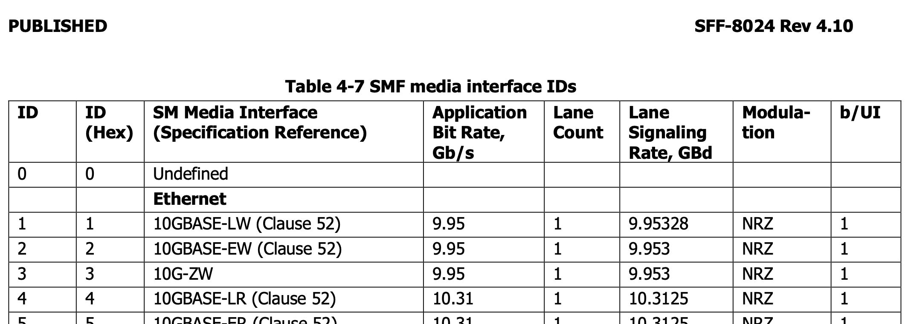
source: [9]
Notes:
full be precise in the specification of your interface, esp. when interconnecting with others.

Slide 45
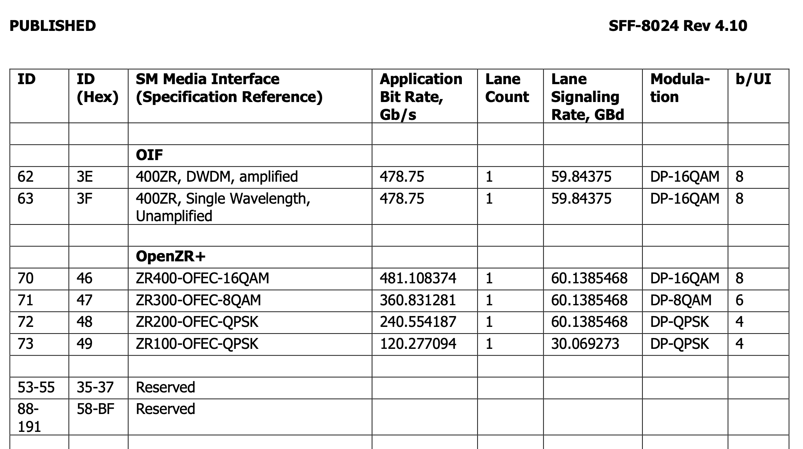
MSA can be a nightmare
?
source: [9]
Notes:
full + OIF 400ZR and IEEE Ethernet 400GBASE-ZR do have the same parameters but there must be a difference
+ Ethernet required 425 GBit/s. So the additional 53 Gbit/ s are used for the modulation (e.g. pilot sequence of the Carrier Phase Recovery) and the FEC

Slide 46
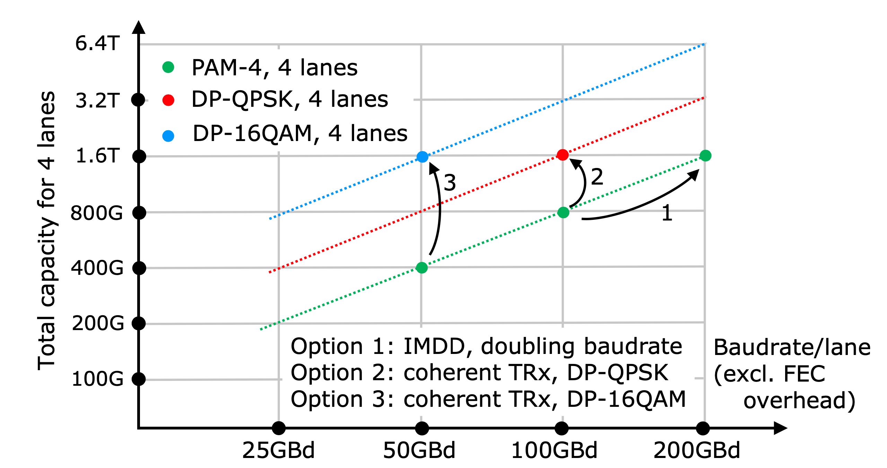
more bandwidth for 800G, 1.6T or 3.2T with coherent
x8
x4
x2
source: [1]
Notes:
+ Result: with pure compute power of the DSP we can increase bandwidth multiple times.
+ diagramm : reference is 50Gbaut NRZ; the initial situation is 100Gbit/s (PAM-4 modulation with 50Gbaud) on 4 lanes = 400GBit. (x2); Modulation is an important key to increase bandwidth
+ different datarate based on formfactors:
400G used PAM-4 on 8 lanes (each running 50Gbit/s PAM-4) modulation and doubles the symbol rate to 2 bits/symbol; applies to QSFP-DD and OSFP; QSFP112 has 4 lanes each handling up to 100Gbit/s PAM-4
800G uses PAM-4 on 8 lanes (each running 100Gbit/s PAM-4); there are plans to run 200Gbit/s PAM-4 per lane for 1,6T (8 lanes); QSFP-DD800 or OSFP – for the electrical interface this is the red path in the diagramm. but ignoring the 4 lanes as for 800G or 1.6T there are minimum 8 lanes used.
1.6T based on OSFP-XD has 16 lanes each handling up to 100Gbit/s
+ with DP-16QAM on the optical path you get 4 bits/symbol x 2 polarizations (x8) with 50Gbaud = 400Gbit/s per lane (4 lanes = 1,6T)

Slide 47
thomas.weible@flexoptix.net gerhard.stein@flexoptix.net
Want to learn for yourself?
Your switch gear
+ our coherent optics
= less hickups, more knowhow
thank you!
Notes:
We are happy to do more testing in different gear of various vendors. Feel free to contact us: thomas.weible@flexoptix.net and gerhard.stein@flexoptix.net

Slide 48
DR4
400G DR4+
DR
FR
PLR4
LR
400G LR4​
400G LR8​

Slide 49
comparison of
OPEX
CAPEX
x20​
100G DCI vs. 400G Coherent
n/a
x3
100G vs. 400G Coherent
x1​
x1.5
400G vs. 800G grey
x0.8​
Notes:
the red circled datarate is the reference, e.g. 1 x 800G QSFP-DD costs 1,5 times more than 2 x 400G QSFP-DD when purchasing
100G DCI vs. 400G Coherent ist based on data from AMS-IX "Saving Power by using 400G- ZR+ high-power for AMS-IX backbone" - eric.nguyenduy@ams-ix.net. "100G DCI" is meant to be a shelf based transponder card / unit.
100G vs. 400G Coherent comparision of Q.CO161HG.22.yT vs. D.CO164HG.2.yT
400G vs. 800G grey comparision of D.134HG.05 vs. D.138HG.05.M
based on data available July 2024

Slide 50
Outlook: OpenXR 16 x 25Gbit/s via DSCM
source: [7]
Notes:
Flexible Point-to-Multipoint: make full use of the DSP capabilities to generate different channels and distinguish between them
OpenXR is another forum of vendors like OpenZR+ and OIF

Slide 51
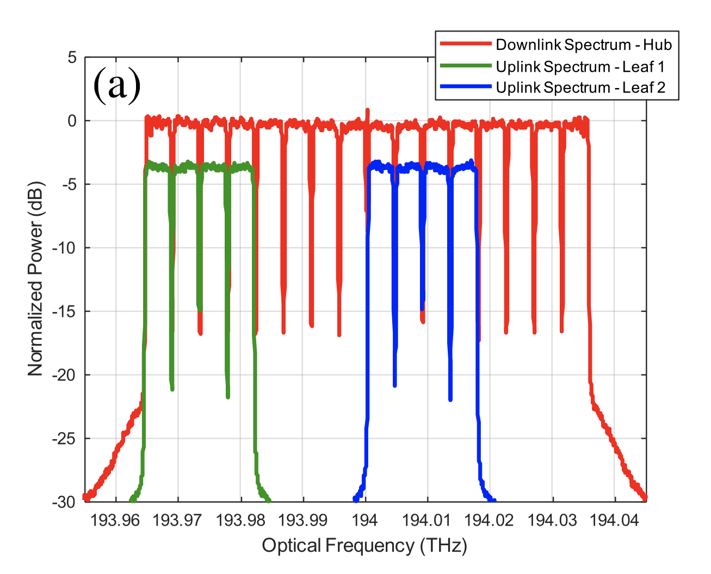
Outlook: DSCM (Digital SubCarrier Multiplexing)
source: [7]
source: [8]
Notes:
note: only the spectrum for 2 x 100G is shown in the diagramm

Slide 52
References
High Speed Transceivers beyond 1.6Tb/s for Data Centre Networks, Osseiur et al. 2023, Ghent University – imec, Belgium
Introduction to Applications of XR Optics to Coherent Optical Communication Networks OXR DOCUMENT OXR.APPS-INTRO.01.0; July 2022
Lumentum Operations LLC, https://www.lumentum.com/en/products/400g-zrzr-qsfp-dd-dco (accessed Nov. 2023)
400G ZR(+) Real World Examples, Florian Hibler, Arista ; Networks GmbH ; DENOG14 (Nov. 2022)
OIF-400ZR-02.0, Implementation Agreement 400ZR, OIForum; November 3rd of 2022
EVOLVING THE AWARENESS OF OPTICAL NETWORKS, Infinera Corporation, https://www.infinera.com/wp-content/uploads/Evolving-the-Awareness-of-Optical-Networks-0179-WP-RevA-0519.pdf (Accessed Nov 2023)
Digital Subcarrier Multiplexing: Enabling Software-Configurable Optical Networks, Dave Welch et. Al. February 15th of 2023, JOURNAL OF LIGHTWAVE TECHNOLOGY, VOL. 41, NO. 4
SFF-8024, SFF Module Management Reference Code Tables, Rev. 4.10, November 24th of 2022
Rotary optical encoder model, https://commons.wikimedia.org/wiki/File:Encoder.jpg by Rrudzik (accessed Mar. 2024)

